Slide 1







Introduction to Management
Engineering Management MGT3202
Prepared by
Sadia Rahman
Faculty of Business Administration
1-<number>

Slide 2
Topics
Management - Key concepts
Levels of Management
Managing for Competitive Advantages
Organizational Performance
Managerial Functions
Managerial Roles
Managerial Skills
Skills in different Level
Management Challenges
Management in New era

Slide 3




Manager & Management
Organizations comprises of People working together and coordinating their actions to achieve specific goals.
Manager is someone who coordinates and oversees the work of other people so that organizational goals and objectives can be accomplished.
Goal: A desired future condition that the organization seeks to achieve.
Management in all business areas and organizational activities are the acts of getting people together to accomplish desired goals and objectives.

Slide 4
Additional Key Concepts
Resources are organizational assets and include:
    People,
    Machinery,
    Raw materials,
    Information, skills,
    Financial capital.

Slide 5
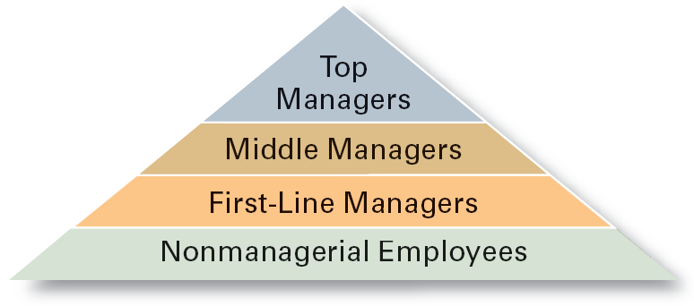
Three Levels of Management
Top Managers
Middle Managers
First-line Managers
Non-management

Slide 6
Classifying Managers
First-line Managers
  Individuals who manage the work of non-managerial employees.
Middle Managers
  Individuals who manage the work of first-line managers.
Top Managers
  Individuals who are responsible for making organization-wide decisions and establishing plans and goals that affect the entire organization.

Slide 7

MANAGING FOR COMPETITIVE ADVANTAGE
Cost
Competitiveness
Innovation
Competitive advantage is a position of a company in a competitive landscape that allows the company earning return on investments higher than the cost of investments
Quality
Speed
1-<number>

Slide 8
MANAGING FOR COMPETITIVE ADVANTAGE (CONTD.)
Cost competitiveness
  costs are kept low enough so that you can realize profits and price your products at levels that are attractive to consumers
  key is efficiency - accomplishing goals by using resources wisely and minimizing waste
Quality
  excellence of a product, including its attractiveness, lack of defects, reliability, and long-term durability
  importance of quality has increased dramatically
  must identify specific elements of quality to correct problems, target needs, and deliver world-class value

Slide 9
MANAGING FOR COMPETITIVE ADVANTAGE (CONTD.)
Speed
  often separates winners from losers in world competition
  speed became a vital requirement in the 1990s
    requirement has increased exponentially
Innovation
  the introduction of new goods and services
  important to adapt to changes in consumer demands and to new sources of competition
Best managers and companies delivering all four

Slide 10
Organizational Performance
Measures how efficiently and effectively managers use resources to satisfy customers and achieve goals.
  Efficiency: A measure of how well resources are used to achieve a goal.
    Usually, managers must try to minimize the input of resources to attain the same goal.
  Effectiveness: A measure of the appropriateness of the goals chosen (are these the right goals?), and the degree to which they are achieved.
    Organizations are more effective when managers choose the correct goals and then achieve them.

Slide 11
Efficiency and Effectiveness
  Efficiency
    -“Doing things right”
      Getting the most output for the least inputs
  Effectiveness
    -“Doing the right things”
      Attaining organizational goals

Slide 12
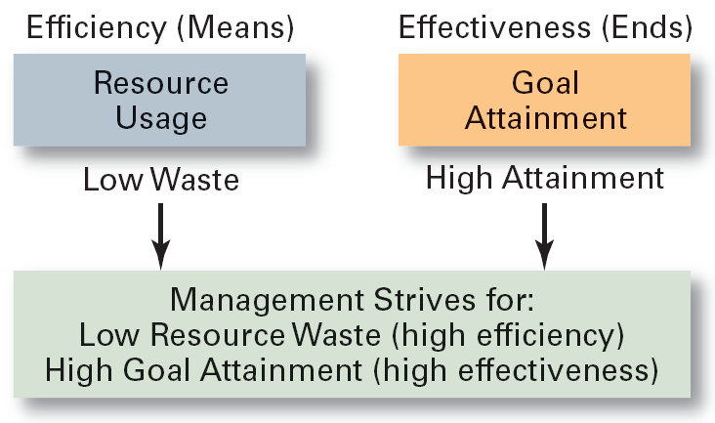
Efficiency and Effectiveness

Slide 13
Managerial Functions
Henri Fayol was the first to describe the four managerial functions when he was the CEO of a large mining company in the later 1800’s.
Fayol noted managers at all levels, operating in a for profit or not for profit organization, must perform each of the functions of:
  Planning,
  organizing,
  leading,
  controlling.

Slide 14
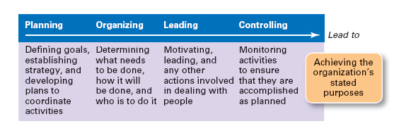
Managerial Functions
THE FUNCTIONS OF MANAGEMENT (CONTD.)
Leading
Organizing
Controlling
Planning

Slide 15
Planning
Planning is the process used by managers to identify and select appropriate goals and courses of action for an organization.
3 steps to good planning :
  1. Which goals should be pursued?
  2. How should the goal be attained?
  3. How should resources be allocated?
  The planning function determines how effective and efficient the organization is and determines the strategy of the organization.

Slide 16
Organizing
In organizing, managers create the structure of working relationships between organizational members that best allows them to work together and achieve goals.
Managers will group people into departments according to the tasks performed.
  Managers will also lay out lines of authority and responsibility for members.
An organizational structure is the outcome of organizing. This structure coordinates and motivates employees so that they work together to achieve goals.

Slide 17
Leading
In leading, managers determine direction, state a clear vision for employees to follow, and help employees understand the role they play in attaining goals.
Leadership involves a manager using power, influence, vision, persuasion, and communication skills.
The outcome of the leading function is a high level of motivation and commitment from employees to the organization.

Slide 18
Controlling
In controlling, managers evaluate how well the organization is achieving its goals and takes corrective action to improve performance.
Managers will monitor individuals, departments, and the organization to determine if desired performance has been reached.
  Managers will also take action to increase performance as required.
The outcome of the controlling function is the accurate measurement of performance and regulation of efficiency and effectiveness.

Slide 19
Managerial Roles
Described by Mintzberg.
  A role is a set of specific tasks a person performs because of the position they hold.
Roles are directed inside as well as outside the organization.
There are 3 broad role categories:
  1. Interpersonal
  2. Informational
  3. Decisional

Slide 20
Interpersonal Roles
Managerial roles that involve people and other duties that are ceremonial and symbolic in nature
  Figurehead role: symbolizes the organization and what it is trying to achieve.
  Leader role: train, counsel, mentor and encourage high employee performance.
  Liaison role: link and coordinate people inside and outside the organization to help achieve goals.

Slide 21
Informational Roles
  Managerial roles that involve receiving, collecting and disseminating information.
  Monitor role: analyzes information from both the internal and external environment.
  Disseminator role: manager transmits information received from outsiders or from subordinates to members of the organization
  Spokesperson role: Transmits information to outsiders on organization’s plans, policies, actions, results etc.

Slide 22
Decisional Roles
Associated with the methods managers use to plan strategy and utilize resources to achieve goals.
  Entrepreneur role: deciding upon new projects or programs to initiate and invest.
  Disturbance handler role: assume responsibility for handling an unexpected event or crisis.
  Resource allocator role: assign resources between functions and divisions, set budgets of lower managers.
  Negotiator role: seeks to negotiate solutions between other managers, unions, customers, or shareholders.

Slide 23
Managerial Skills
There are three skill sets that managers need to perform effectively.
  1. Conceptual skills: the ability to analyze and diagnose a situation and find the cause and effect.
  2. Human skills: the ability to understand, alter, lead, and control people’s behavior.
  3. Technical skills: the job-specific knowledge required to perform a task. Common examples include marketing, accounting, and manufacturing.
All three skills are enhanced through formal training, reading, and practice.

Slide 24
Skill Type Needed by Manager Level
Top
Managers
Middle
Managers
Line
Managers
Conceptual
Human
Technical

Slide 25
Management Challenges
Increasing number of global organizations.
Building competitive advantage through superior efficiency, quality, innovation, and responsiveness.
Increasing performance while remaining ethical managers.
Managing an increasingly diverse work force.
Using new technologies.

Slide 26
Management in New Era
The Internet
  changes the way management must think and act
  chief Web officer will be one of the most important jobs
    will oversee information systems and strategies
    will create and manage business relationships via new communications technologies
  great companies will capitalize most fully on the Web’s potential
  distinction between Internet and non-Internet companies is fading

Slide 27

Management in New Era (contd.)
Globalization
  isolationism is a thing of the past
  multinational enterprises have sales offices all over the world
  corporations use their transnational status to operate beyond the control of national governments
  even small firms that do not operate on a global scale must make strategic decisions based on international considerations

Slide 28
Management in New Era (contd.)
Knowledge management
  set of practices aimed at discovering and harnessing an organization’s intellectual resources
    unlock people’s expertise, skills, wisdom, and relationships
  intellectual capital is the collective brainpower of the organization
Collaboration across “boundaries”
  capitalize on the ideas of people outside the traditional company “boundaries”
    must effectively capitalize on customers’ brains
      get customers to think creatively to identify new product and service ideas

Slide 29
Thank you
1-<number>

